Slide 1

CHAPTER 2
THE LOGIC OF
COMPOUND STATEMENTS
Copyright © Cengage Learning. All rights reserved.

Slide 2
SECTION 2.1
Logical Form and Logical Equivalence
Copyright © Cengage Learning. All rights reserved.

Slide 3
Logical Form and Logical Equivalence
The central concept of deductive logic is the concept of argument form. An argument is a sequence of statements aimed at demonstrating the truth of an assertion.
The assertion at the end of the sequence is called the conclusion, and the preceding statements are called premises.
To have confidence in the conclusion that you draw from an argument, you must be sure that the premises are acceptable on their own merits or follow from other statements that are known to be true.

Slide 4


Example 1 – Identifying Logical Form
Fill in the blanks below so that argument (b) has the same form as argument (a). Then represent the common form of the arguments using letters to stand for component sentences.
a. If Jane is a math major or Jane is a computer science
major, then Jane will take Math 150. Jane is a computer
science major. Therefore, Jane will take Math 150.
b. If logic is easy or , then .
I will study hard.
Therefore, I will get an A in this course.

Slide 5
Example 1 – Solution
1. I (will) study hard.
2. I will get an A in this course.
Common form: If p or q, then r.
q.
Therefore, r.

Slide 6
Statements

Slide 7
Statements
Most of the definitions of formal logic have been developed so that they agree with the natural or intuitive logic used by people who have been educated to think clearly and use language carefully.
The differences that exist between formal and intuitive logic are necessary to avoid ambiguity and obtain consistency.
In any mathematical theory, new terms are defined by using those that have been previously defined. However, this process has to start somewhere. A few initial terms necessarily remain undefined.

Slide 8
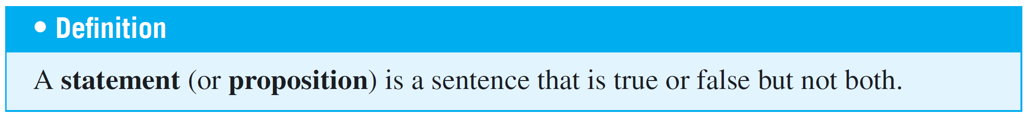
Statements
In logic, the words sentence, true, and false are the initial
undefined terms.

Slide 9
Compound Statements

Slide 10
Compound Statements
We now introduce three symbols that are used to build more
complicated logical expressions out of simpler ones.
The symbol ~ denotes not, ∧ denotes and, and ∨ denotes or.
Given a statement p, the sentence “~p” is read “not p” or “It is not the case that p” and is called the negation of p. In some computer languages the symbol  is used in place of ~.

Slide 11
Compound Statements
Given another statement q, the sentence “p ∧ q” is read “p and q” and is called the conjunction of p and q.
The sentence “p ∨ q” is read “p or q” and is called the disjunction of p and q.
In expressions that include the symbol ~ as well as ∧ or ∨, the order of operations specifies that ~ is performed first.
For instance, ~p ∧ q = (~p) ∧ q.

Slide 12
Compound Statements
In logical expressions, as in ordinary algebraic expressions, the order of operations can be overridden through the use
of parentheses.
Thus ~(p ∧ q) represents the negation of the conjunction
of p and q.
In this, as in most treatments of logic, the symbols ∧ and ∨ are considered coequal in order of operation, and an expression such as p ∧ q ∨ r is considered ambiguous.
This expression must be written as either (p ∧ q) ∨ r or
p ∧ (q ∨ r) to have meaning.

Slide 13
Example 2 – Translating from English to Symbols: But and Neither-Nor
Write each of the following sentences symbolically, letting
h = “It is hot” and s = “It is sunny.”
a. It is not hot but it is sunny.
b. It is neither hot nor sunny.
Solution:
a. The given sentence is equivalent to “It is not hot and it is
sunny,” which can be written symbolically as ~h ∧ s.
b. To say it is neither hot nor sunny means that it is not hot
and it is not sunny. Therefore, the given sentence can be
written symbolically as ~h ∧ ~s.

Slide 14
Truth Values

Slide 15
Truth Values
In Example 2 we built compound sentences out of component statements and the terms not, and, and or.
If such sentences are to be statements, however, they must have well-defined truth values—they must be either true or false.
We now define such compound sentences as statements by specifying their truth values in terms of the statements that compose them.

Slide 16
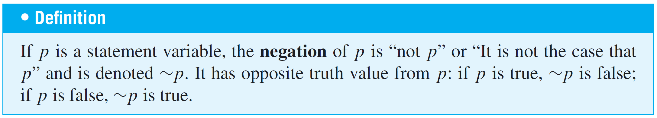
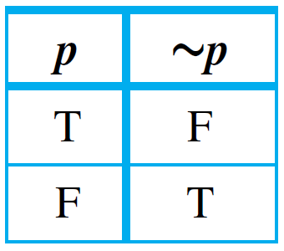
Truth Values
The negation of a statement is a statement that exactly expresses what it would mean for the statement to be false.
The truth values for negation are summarized in a truth table.
Truth Table for ~p

Slide 17
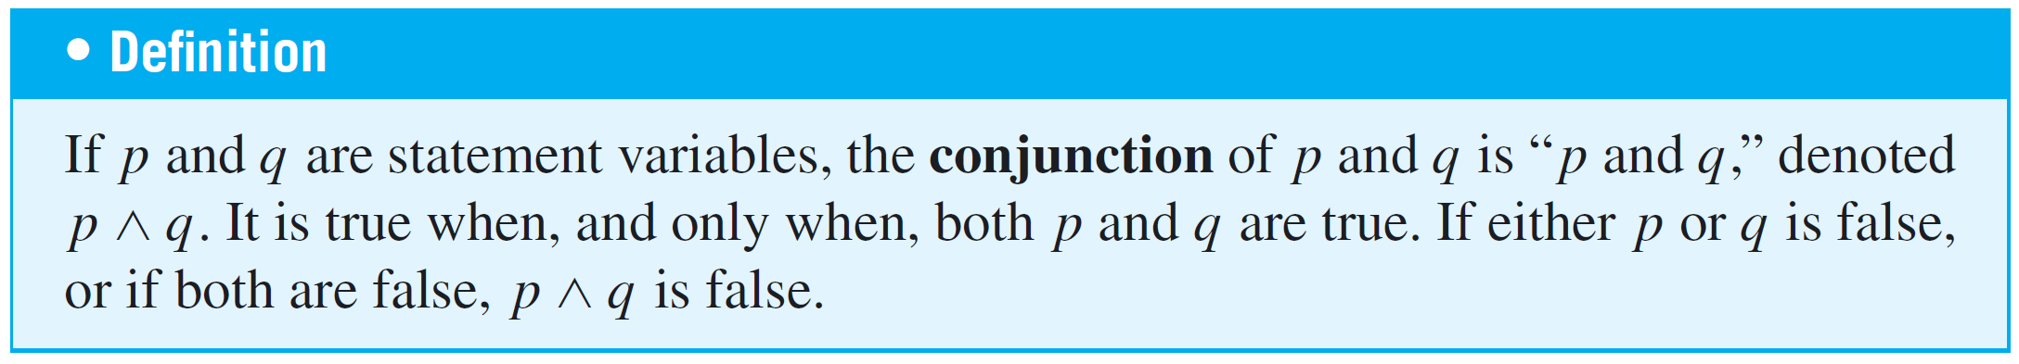
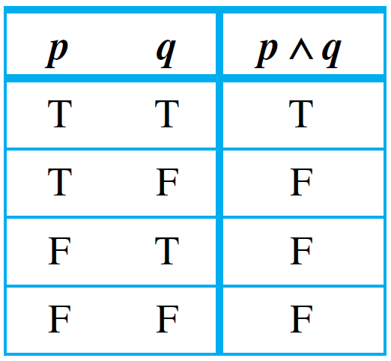
Truth Values
The truth values for conjunction can also be summarized in a truth table.
Truth Table for p ∧ q

Slide 18
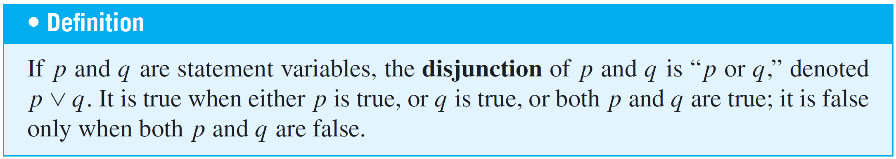
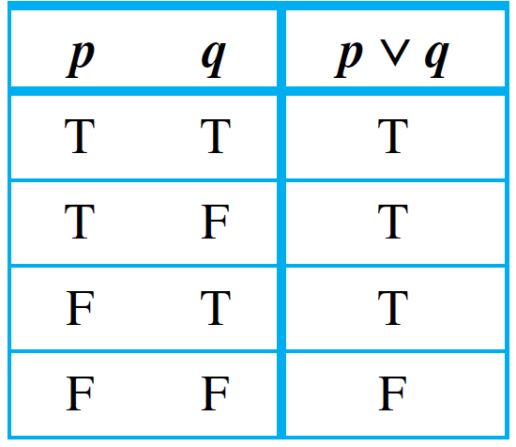
Truth Values
Here is the truth table for disjunction:
Truth Table for p ∨ q

Slide 19
Evaluating the Truth of More General Compound Statements

Slide 20
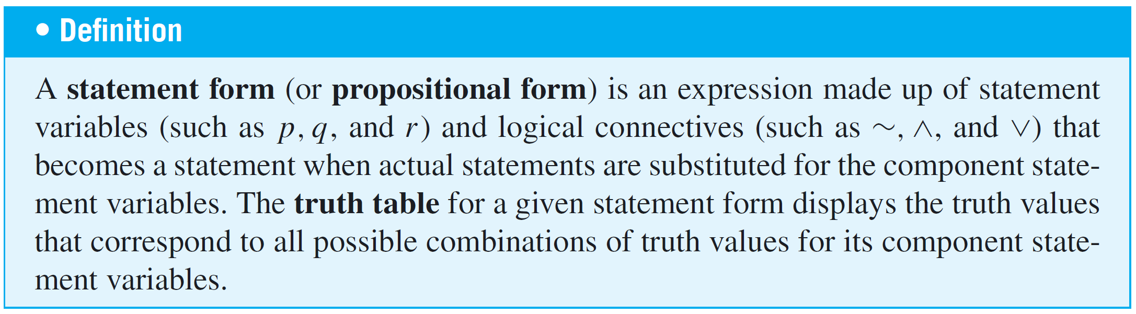
Evaluating the Truth of More General Compound Statements
Now that truth values have been assigned to ~p, p ∧ q, and p ∨ q, consider the question of assigning truth values to more complicated expressions such as ~p ∨ q,
(p ∨ q) ∧ ~(p ∧ q), and (p ∧ q) ∨ r. Such expressions are called statement forms (or propositional forms).

Slide 21
Evaluating the Truth of More General Compound Statements
To compute the truth values for a statement form, follow rules similar to those used to evaluate algebraic expressions.
For each combination of truth values for the statement variables, first evaluate the expressions within the innermost parentheses, then evaluate the expressions within the next innermost set of parentheses, and so forth until you have the truth values for the complete expression.

Slide 22

Example 4 – Truth Table for Exclusive Or
Construct the truth table for the statement form
(p ∨ q) ∧ ~(p ∧ q).
Note that when or is used in its exclusive sense, the statement “p or q” means “p or q but not both” or “p or q and not both p and q,” which translates into symbols as
(p ∨ q) ∧ ~(p ∧ q).
This is sometimes abbreviated

Slide 23
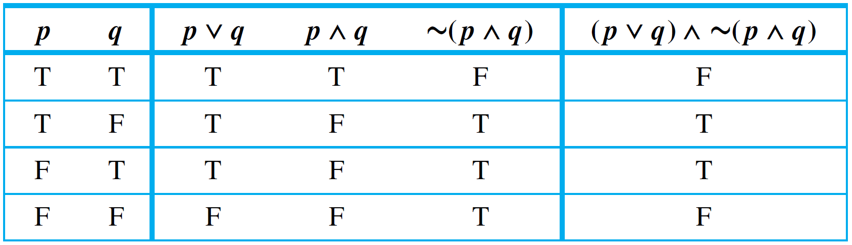
Example 4 – Solution
Set up columns labeled p, q, p ∨ q, p ∧ q, ~(p ∧ q), and
(p ∨ q) ∧ ~(p ∧ q).
Fill in the p and q columns with all the logically possible combinations of T’s and F’s. Then use the truth tables for ∨
and ∧ to fill in the p ∨ q and p ∧ q columns with the
appropriate truth values.
Truth Table for Exclusive Or: (p ∨ q) ∧ ~( p ∧ q)

Slide 24
Example 4 – Solution
cont’d
Next fill in the ~(p ∧ q) column by taking the opposites of the truth values for p ∧ q.
For example, the entry for ~(p ∧ q) in the first row is F because in the first row the truth value of p ∧ q is T.
Finally, fill in the (p ∨ q) ∧ ~(p ∧ q) column by considering the truth table for an and statement together with the
computed truth values for p ∨ q and ~(p ∧ q).

Slide 25
Example 4 – Solution
cont’d
The entry in the second row is T because both components are true in this row.
Truth Table for Exclusive Or: (p ∨ q) ∧ ~( p ∧ q)

Slide 26
Logical Equivalence

Slide 27
Logical Equivalence
The statements
6 is greater than 2 and 2 is less than 6
are two different ways of saying the same thing. Why? Because of the definition of the phrases greater than and less than. By contrast, although the statements
(1) Dogs bark and cats meow
and
(2) Cats meow and dogs bark
are also two different ways of saying the same thing, the reason has nothing to do with the definition of the words.

Slide 28
Logical Equivalence
It has to do with the logical form of the statements.
Any two statements whose logical forms are related in the same way as (1) and (2) would either both be true or both be false.
You can see this by examining the following truth table, where the statement variables p and q are substituted for the component statements “Dogs bark” and “Cats meow,” respectively.

Slide 29
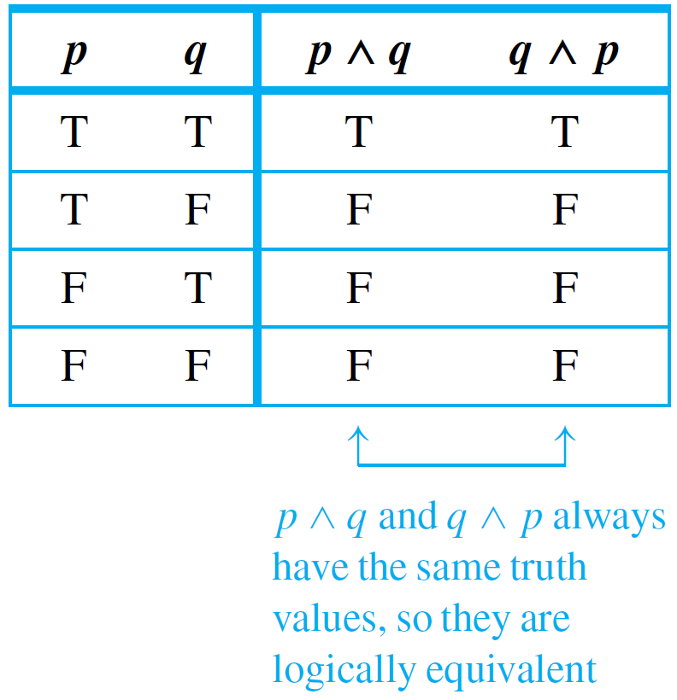
Logical Equivalence
The table shows that for each combination of truth values for p and q, p ∧ q is true when, and only when, q ∧ p is true.
In such a case, the statement
forms are called logically
equivalent, and we say
that (1) and (2) are
logically equivalent
statements.

Slide 30
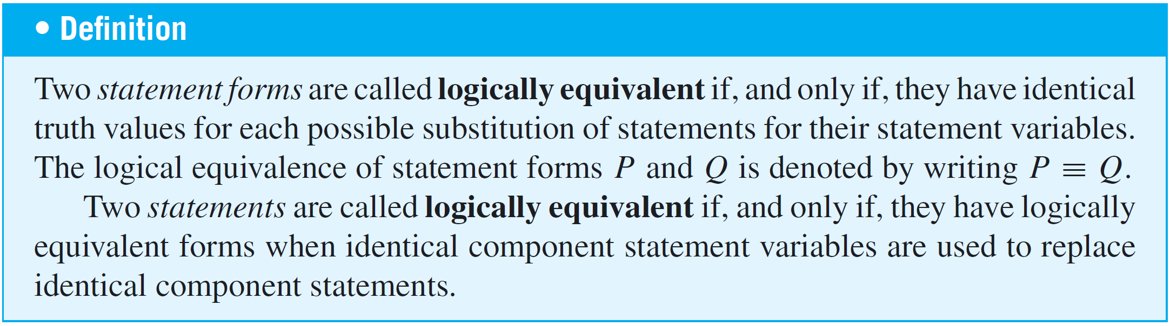
Logical Equivalence
Testing Whether Two Statement Forms P and Q Are Logically Equivalent
1. Construct a truth table with one column for the truth
values of P and another column for the truth values of Q.

Slide 31
Logical Equivalence
2. Check each combination of truth values of the statement
variables to see whether the truth value of P is the same
as the truth value of Q.
a. If in each row the truth value of P is the same as the
truth value of Q, then P and Q are logically equivalent.
b. If in some row P has a different truth value from Q,
then P and Q are not logically equivalent.

Slide 32
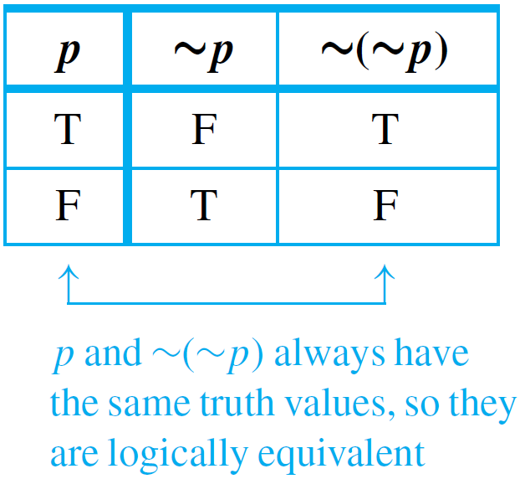
Example 6 – Double Negative Property: ∼(∼p) ≡ p
Construct a truth table to show that the negation of the negation of a statement is logically equivalent to the statement, annotating the table with a sentence of explanation.
Solution:

Slide 33
Logical Equivalence
There are two ways to show that statement forms P and Q are not logically equivalent. As indicated previously, one is to use a truth table to find rows for which their truth values differ.
The other way is to find concrete statements for each of the two forms, one of which is true and the other of which is false.
The next example illustrates both of these ways.

Slide 34
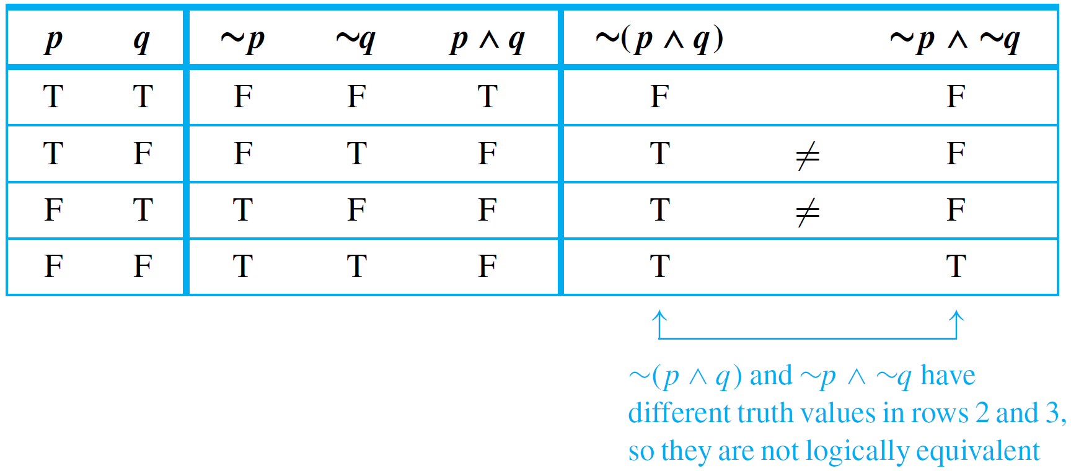
Example 7 – Showing Nonequivalence
Show that the statement forms ~(p ∧ q) and ~p ∧ ~q are not logically equivalent.
Solution:
a. This method uses a truth table annotated with a sentence
of explanation.

Slide 35
Example 7 – Solution
cont’d
b. This method uses an example to show that ~(p ∧ q) and
~p ∧ ~q are not logically equivalent. Let p be the
statement “0 < 1” and let q be the statement “1 < 0.”
Then
which is true.
On the other hand,
which is false.

Slide 36
Example 7 – Solution
cont’d
This example shows that there are concrete statements
you can substitute for p and q to make one of the
statement forms true and the other false.
Therefore, the statement forms are not logically
equivalent.

Slide 37
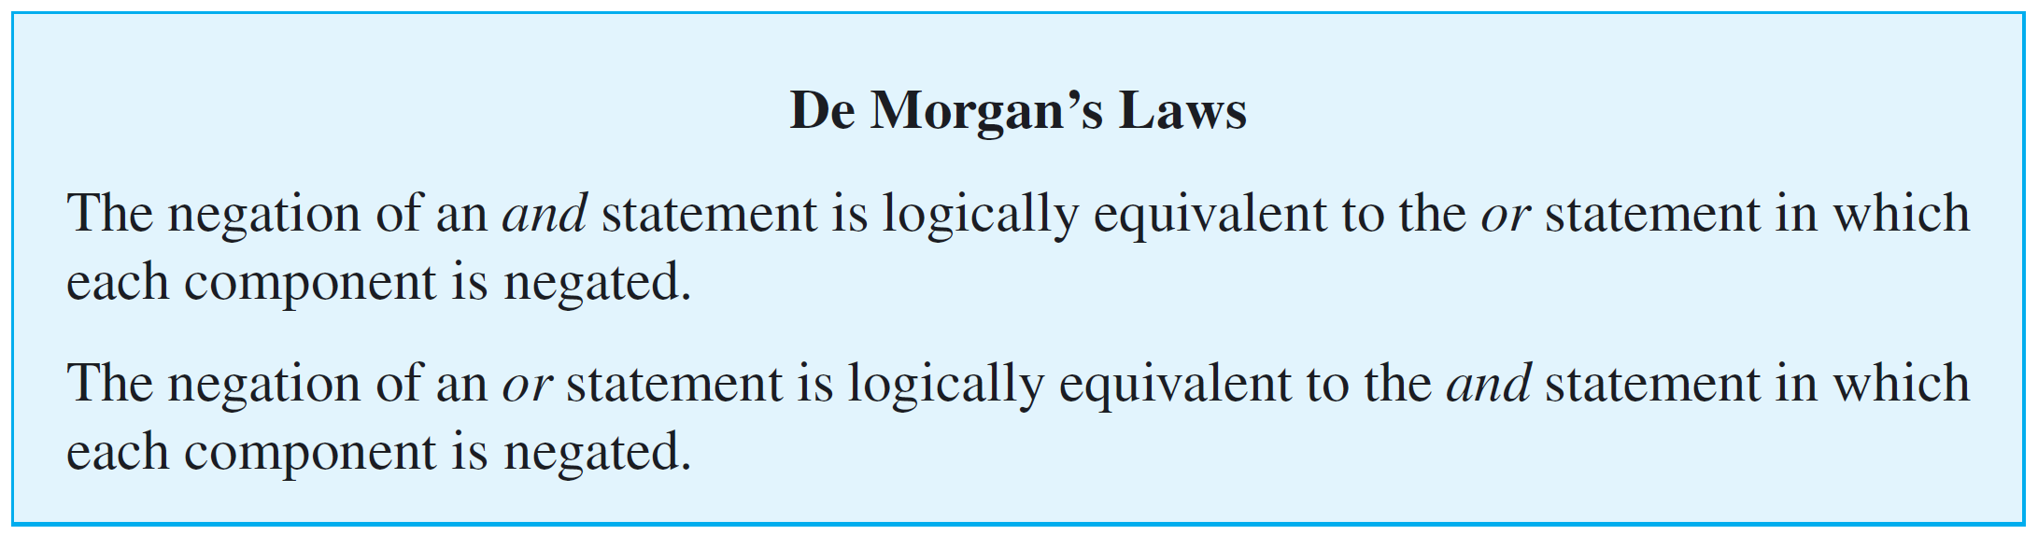
Logical Equivalence
The two logical equivalences are known as De Morgan’s laws of logic in honor of Augustus De Morgan, who was the first to state them in formal mathematical terms.

Slide 38

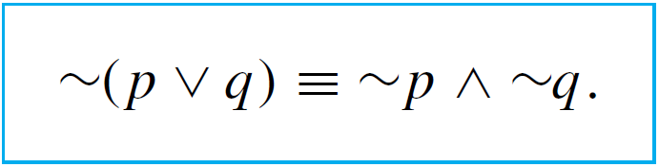
Logical Equivalence
Symbolically we can represent the two logic equivalences as:
and

Slide 39
Example 9 – Applying De Morgan’s Laws
Write negations for each of the following statements:
a. John is 6 feet tall and he weighs at least 200 pounds.
b. The bus was late or Tom’s watch was slow.
Solution:
a. John is not 6 feet tall or he weighs less than 200 pounds.
b. The bus was not late and Tom’s watch was not slow.
Since the statement “neither p nor q” means the same as
“~p and ~q,” an alternative answer for (b) is “Neither was the bus late nor was Tom’s watch slow.”

Slide 40
Example 11 – A Cautionary Example
According to De Morgan’s laws, the negation of
p: Jim is tall and Jim is thin
is ~p: Jim is not tall or Jim is not thin
because the negation of an and statement is the or statement in which the two components are negated.
Unfortunately, a potentially confusing aspect of the English language can arise when you are taking negations of this kind. Note that statement p can be written more compactly as
p′: Jim is tall and thin.

Slide 41
Example 11 – A Cautionary Example
cont’d
When it is so written, another way to negate it is
~(p′): Jim is not tall and thin.
But in this form the negation looks like an and statement.
Doesn’t that violate De Morgan’s laws?
Actually no violation occurs. The reason is that in formal logic the words and and or are allowed only between complete statements, not between sentence fragments.

Slide 42
Example 11 – A Cautionary Example
cont’d
One lesson to be learned from this example is that when
you apply De Morgan’s laws, you must have complete
statements on either side of each and and on either side of
each or.

Slide 43
Tautologies and Contradictions

Slide 44
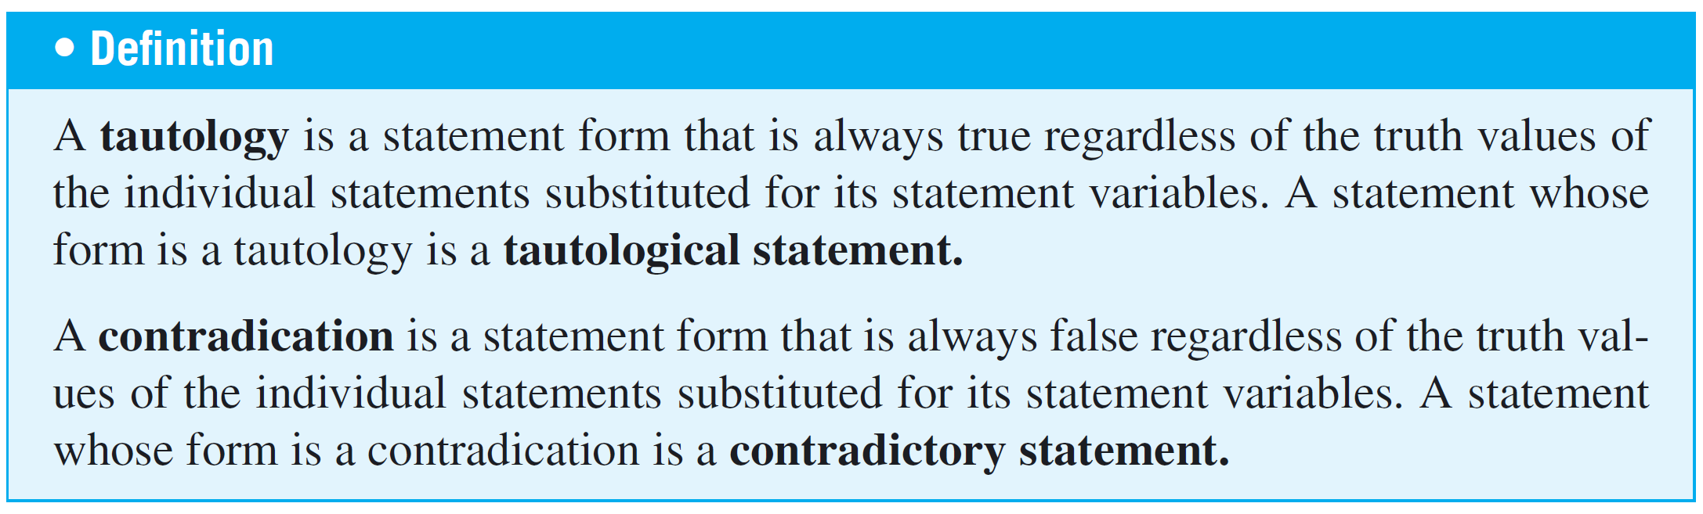
Tautologies and Contradictions
According to this definition, the truth of a tautological statement and the falsity of a contradictory statement are due to the logical structure of the statements themselves and are independent of the meanings of the statements.

Slide 45
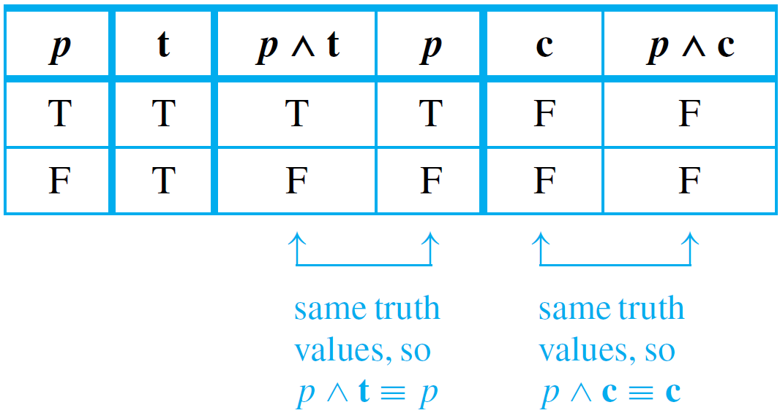
Example 13 – Logical Equivalence Involving Tautologies and Contradictions
If t is a tautology and c is a contradiction, show that
p ∧ t ≡ p and p ∧ c ≡ c.
Solution:

Slide 46
Summary of Logical Equivalences

Slide 47
Summary of Logical Equivalences
Knowledge of logically equivalent statements is very useful for constructing arguments.
It often happens that it is difficult to see how a conclusion follows from one form of a statement, whereas it is easy to see how it follows from a logically equivalent form of the statement.

Slide 48
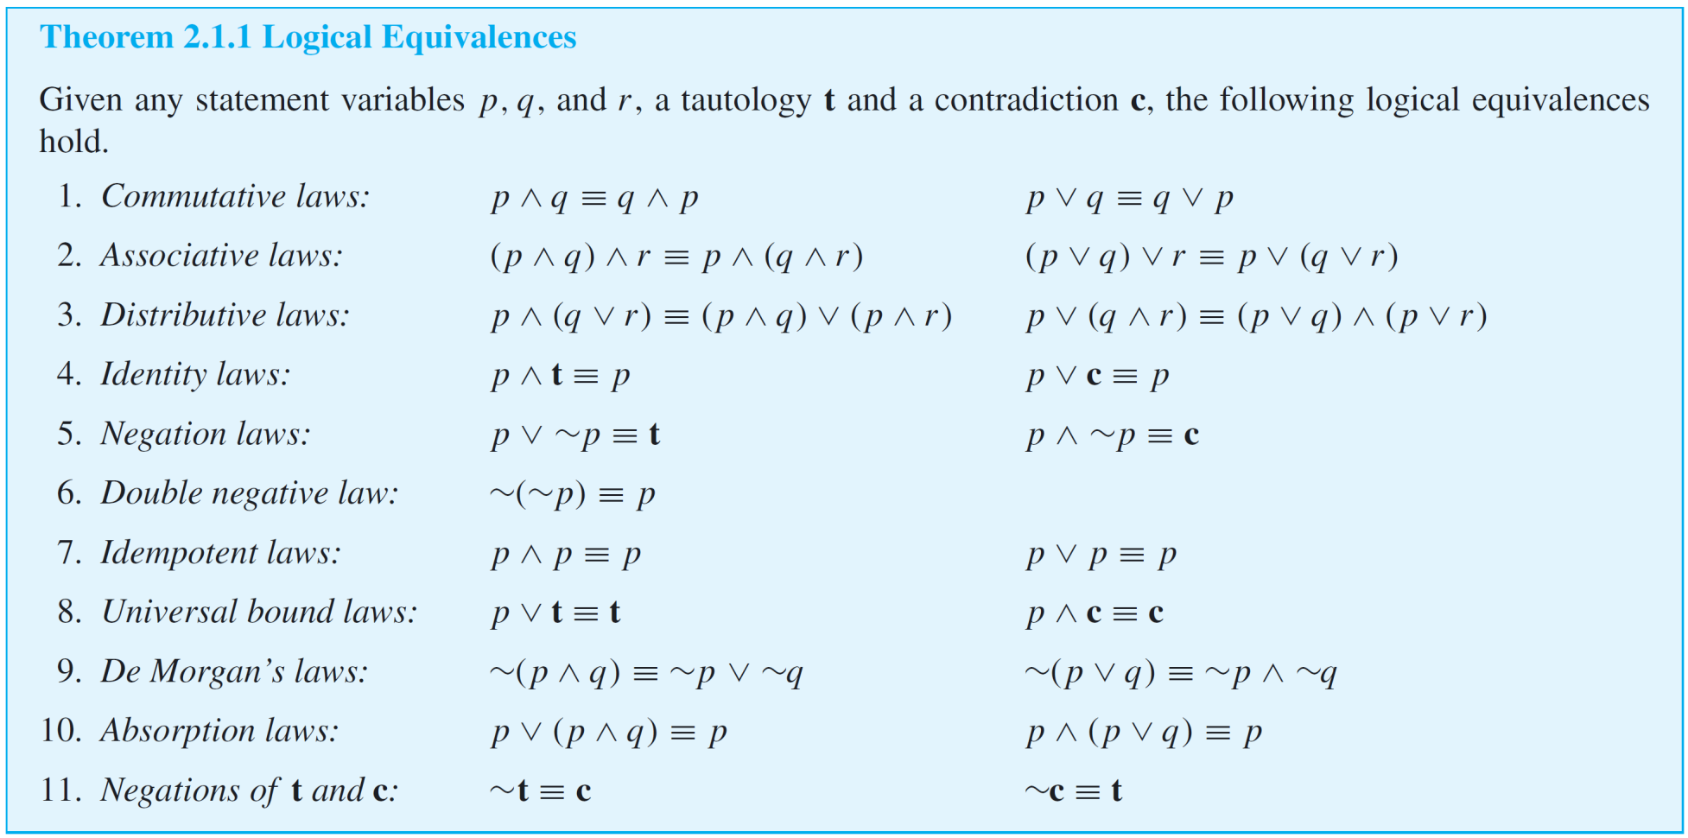
Summary of Logical Equivalences
A number of logical equivalences are summarized in Theorem 2.1.1 for future reference.

Slide 49
Example 14 – Simplifying Statement Forms
Use Theorem 2.1.1 to verify the logical equivalence
Solution:
Use the laws of Theorem 2.1.1 to replace sections of the statement form on the left by logically equivalent expressions.
Each time you do this, you obtain a logically equivalent statement form.

Slide 50








Example 14 – Solution
cont’d
Continue making replacements until you obtain the statement form on the right.

